Slide 1
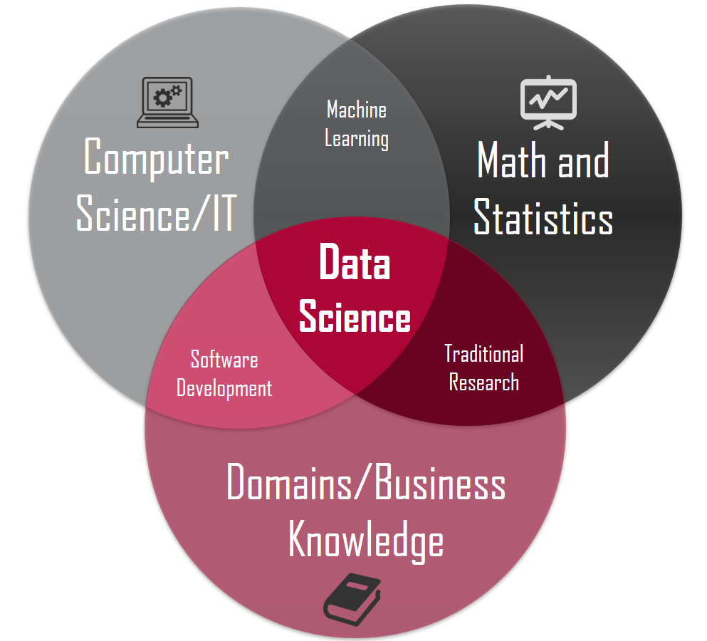
Machine Learning Introduction
This Photo by Unknown Author is licensed under CC BY-SA

Slide 2
Content
Definition of Terminologies
Process / steps of machine learning
Categories of ML models
Practical example
Q & A

Slide 3

Terminologies

Slide 4

What is the difference?
Data Science
Machine Learning
Deep Learning
Artificial Intelligence

Slide 5
Differences
Data science – This is an interdisciplinary field that focuses on extracting knowledge from data sets which are typically huge in amount. The field encompasses analysis, preparing data for analysis, and presenting findings to inform high-level decisions in an organization. As such, it incorporates skills from computer science, mathematics, statistics, information visualization, graphic, and business.
Artificial Intelligence - It is the study of how to train the computers so that computers can do things which at present humans can do better. Artificial refers to something which is made by humans, or a non-natural thing and Intelligence means the ability to understand or think. It is the study of how to train the computers so that computers can do things which at present humans can do better.
Machine Learning -This is a system of computer algorithms that can learn from examples through self-improvement without being explicitly coded by a programmer.
Deep Learning – This is a subset of machine learning that uses neural networks with multiple layers to analyze complex patterns and relationships in data. It is inspired by the structure and function of the human brain, and has been successful in a variety of tasks, such as image recognition, natural language processing, and speech recognition.

Slide 6

Common Terms
Training, Validation and Testing
Underfitting - Happens when you don’t offer a model enough information
Overfitting - Happens when a model considers too much information
Bias - Difference between the prediction of the values by the ML model and the correct value
Variance - How spread the values are
Residual (Error) - How much a real value differs from some statistical value
Outlier
Normalize
Bias-Variance Trade off
Regularization

Slide 7
Categories of Machine learning
There two categories of machine learning
Supervised learning - This is a technique where the program is given labelled input data and the expected output data. There are two categories of supervised learning:-
Classification task – The output is probability of belonging to a group e.g predict gender of a person
Regression task – The output of the model is usually a continuous value e.g forecast value of stock
Unsupervised Learning - This is an algorithm that explores input data without being given an explicit output variable (e.g., explores customer demographic data to identify patterns). It is mostly used in exploratory analysis as it can automatically identify the structure in data.
There are many more grouping
Reinforcement Learning - This models are used in making a sequence of decisions. It is learning by interacting with the environment. It is based on the observation that intelligent agents tend to repeat the action that are rewarded for and refrain from action that are punished for. It can be said that it is a trail and error method in finding the best outcome based on experience.

Slide 8
Process / steps of machine learning

Slide 9

ML Pipeline
Data Collection and integration
Exploratory Data Analysis and Visualization
Feature Selection and Engineering
Model Training
Model Evaluation
Prediction

Slide 10
Practical Example

Slide 11
Resources
Machine Learning Glossary | Google Developers
Data Science Terms and Jargon: A Glossary – Dataquest
Bias-Variance Trade off - Machine Learning – GeeksforGeeks
Intro — mlcourse.ai

Slide 12
Thank you

